Slide 1


FEB
17
Daily Review: DNA + Mitosis
Meiosis EI
Meiosis Video
Remember on Tuesday → Mini Quiz 1 On DNA + Mitosis + Meiosis (10 Q’s)
Describe how sex cells are different from other cells in the body
Explain how sex cells are produced by meiosis
Exercise Book
Pen

Slide 2
Do not delete this slide.
This slide is designed so that you can copy the prompt box you need and insert it into your slides.
This slide is hidden and will not be included when presenting your lesson.
TRACK WITH ME
VOCABULARY
1 -
HINT
Students, remember….
CHECK FOR UNDERSTANDING
READ WITH ME
TEACHER CUE
MAKE THE CONNECTION
Students, you already know….
EXTENSION
GESTURE WITH ME

Slide 3
We are learning about Meiosis
TRACK WITH ME
READ WITH ME
1. Describe how sex cells are different from other cells in the body
2. Explain how sex cells are produced by meiosis
DECLARE THE OBJECTIVE
Read the learning objective to your partner.
Notes:
Learning Objectives contain concepts (nouns, big ideas), skills (verbs, measurable behaviours) and sometimes context (restricting or targeting conditions).
●Example: Students will be able to describe the concept of density and apply it to floating and sinking.
●
Success criteria are specific measurable outcomes that if met mean that the student has met the learning objective.
Examples:
•Students will be able to compare densities of substances using mass and volume.
•Students will be able to identify whether a solid or liquid will float or sink in a liquid based on their densities.

Slide 4
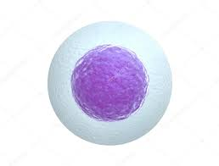
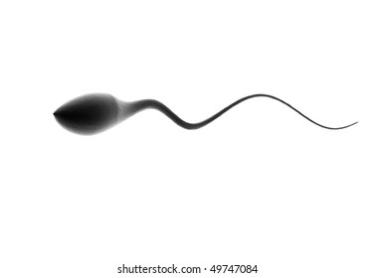
Describe how sex cells are different from other cells in the body
Sexual Reproduction and DNA
Sexual reproduction is the process used by many animals, plants and other organisms to produce offspring.
It involves special sex cells, also known as gametes. In animals, female sex cells are called eggs and male sex cells are called sperm.

Slide 5
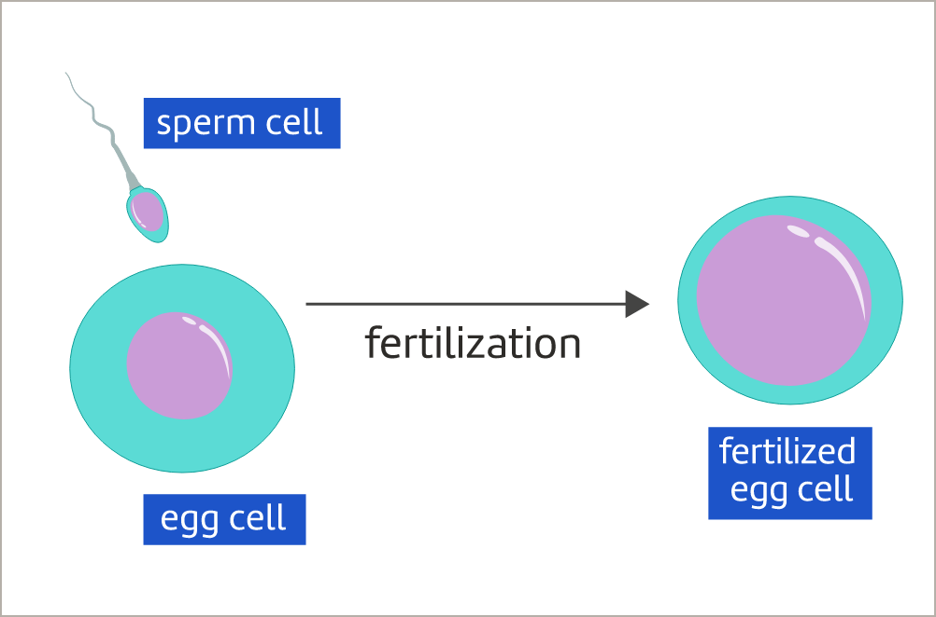
Describe how sex cells are different from other cells in the body
Sexual Reproduction and DNA
Every one of us began as just one cell, created when an egg cell and a sperm cell fused together.
This process is called fertilization. A fertilized egg cell contains DNA from both the mother and father.
This provides the genetic instructions for building a particular human being.

Slide 6

Describe how sex cells are different from other cells in the body
Identify which of the following statements about sex cells are correct.
A. Sex cells are also called gametes
B. Sex cells include skin and nerve cells
C. Male sex cells are called sperm
D. The role of sex cells is to fuse together to form a new organism

Slide 7
Describe how sex cells are different from other cells in the body
Determine how fertilization is related to DNA.
A. Fertilization is the copying of DNA before cell division
B. DNA from the mother and father is joined together by fertilization
C. Fertilization divides DNA into two different types of sex cell
D. DNA is not related to fertilization

Slide 8
Describe how sex cells are different from other cells in the body
Chromosomes
In most human cells, DNA is divided into 46 separate strands, or chromosomes. These are organized into 23 pairs.
One special pair of chromosomes determines a person's sex. These are known as sex chromosomes. Generally, females have two X chromosomes (XX) and males have one X and one Y chromosome (XY).

Slide 9
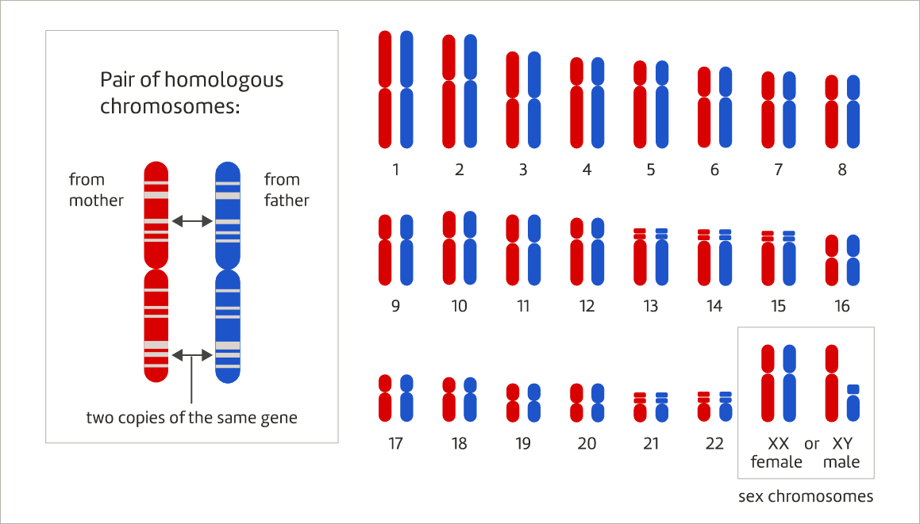
Describe how sex cells are different from other cells in the body
Chromosomes
The remaining 22 pairs are ordered from largest to smallest.
One chromosome in each pair is obtained from the mother's egg cell. The other chromosome is obtained from the father's sperm cell.

Slide 10
Describe how sex cells are different from other cells in the body
Chromosomes
The chromosomes in a pair are the same length and contain copies of the same genes in the same locations. They are described as homologous.
Eye colour is largely determined by a group of genes on chromosome 15. A person's eye colour depends on which versions of the "eye colour genes" they have inherited from their mother and father.

Slide 11
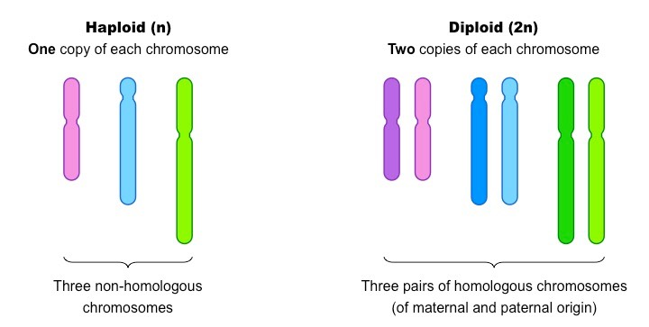
Chromosomes
Teacher Cue
Active tracking, choral reading
Cells can vary in the number of chromosomes they have:
Diploid Cells (Created from Mitosis):
A cell that contains two copies of each chromosome
One copy from each parent
All cells except sex cells are diploid

Slide 12
Chromosomes
Teacher Cue
Active tracking, choral reading
Cells can vary in the number of chromosomes they have:
Haploid Cells (Created from Meiosis):
A cell that contains one copy of each chromosome
Gametes only (sperm and egg cells)

Slide 13
Describe how sex cells are different from other cells in the body
Recall how many pairs of chromosomes are found in most human cells.
A. 2
B. 23
C. 24
D. 46

Slide 14
Describe how sex cells are different from other cells in the body
Identify how many sex chromosomes a person usually has.
A. 1, either X or Y
B. 2, either XX or YY
C. 2, either XX or XY
D. 4, XXXY

Slide 15
Describe how sex cells are different from other cells in the body
Select the option that best completes the sentence.
Two chromosomes are described as homologous if they:
A. Determine the individual’s sex
B. Are obtained from the mother’s egg cell
C. Are obtained from the father’s sperm cell
D. Contain versions of the same genes

Slide 16
2. Explain how sex cells are produced by meiosis
Meiosis
The most common type of cell division in the human body is mitosis. This produces genetically identical cells so that the body can grow and repair.
Meiosis is a special type of cell division that produces sex cells. It involves two cycles of cell division, resulting in four daughter cells. Meiosis is more complicated than mitosis because the daughter cells are genetically different from the parent cell.

Slide 17
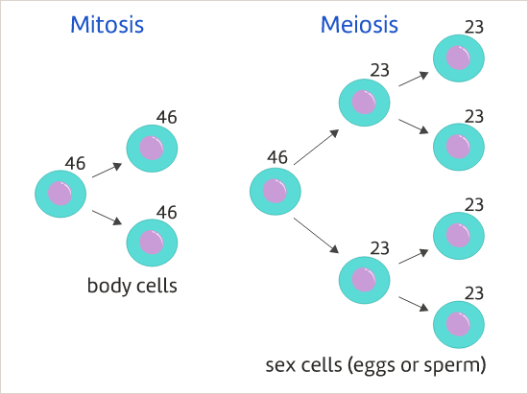
2. Explain how sex cells are produced by meiosis
Meiosis
Sex cells only need 23 chromosomes because two sex cells join together during fertilization.
The new organism gets 23 chromosomes from the mother's egg cell and another 23 from the father's sperm cell.
This produces a full set of 46 chromosomes.

Slide 18
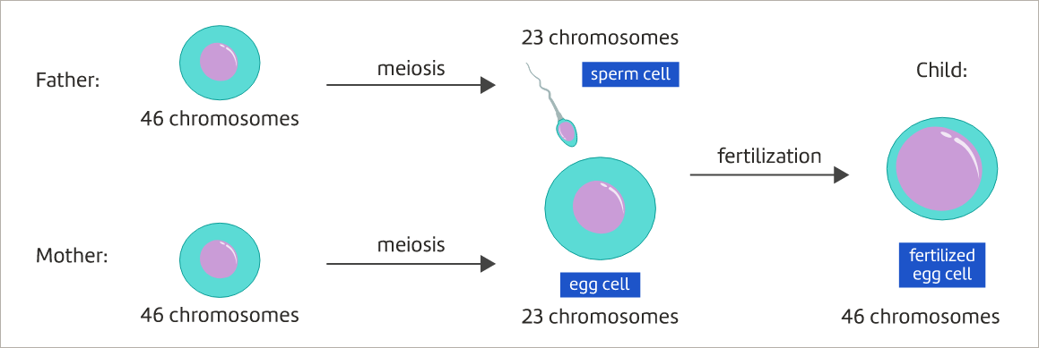
2. Explain how sex cells are produced by meiosis

Slide 19
2. Explain how sex cells are produced by meiosis
In your own words, explain why human sex cells only need 23 chromosomes.

Slide 20
2. Explain how sex cells are produced by meiosis
In your own words, explain why human sex cells only need 23 chromosomes.
The role of sex cells is to pass on genetic information from parents to children during sexual reproduction. When a sperm fertilizes an egg, DNA from the father and the mother joins together to form the full set of DNA the child needs to grow and function.
Most human cells have 46 chromosomes so for the child to get a full set of 46, it needs only 23 chromosomes from each sex cell.

Slide 21

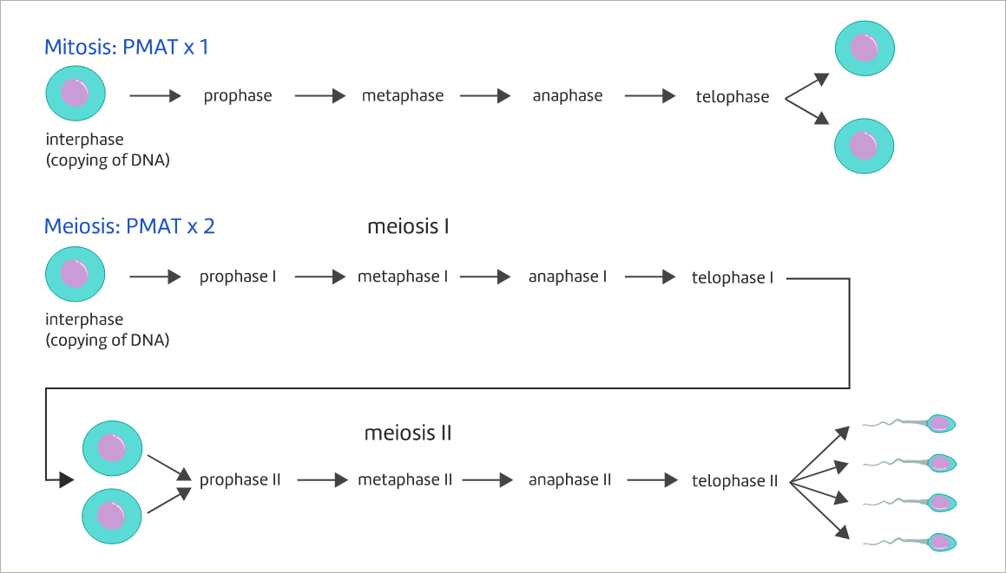
2. Explain how sex cells are produced by meiosis

Slide 22


2. Explain how sex cells are produced by meiosis

Slide 23

2. Explain how sex cells are produced by meiosis

Slide 24
We are learning about Meiosis
TRACK WITH ME
READ WITH ME
1. Describe how sex cells are different from other cells in the body
2. Explain how sex cells are produced by meiosis
DECLARE THE OBJECTIVE
Read the learning objective to your partner.
Notes:
Learning Objectives contain concepts (nouns, big ideas), skills (verbs, measurable behaviours) and sometimes context (restricting or targeting conditions).
●Example: Students will be able to describe the concept of density and apply it to floating and sinking.
●
Success criteria are specific measurable outcomes that if met mean that the student has met the learning objective.
Examples:
•Students will be able to compare densities of substances using mass and volume.
•Students will be able to identify whether a solid or liquid will float or sink in a liquid based on their densities.

Slide 25


Slide 28
Notes:
Please include tasks/questions here rather than just referring to a worksheet. This will save on photocopying and facilitate sharing with other schools.
Try and build tasks/questions which escalate through Bloom’s Taxonomy. This will help with differentiation.

Slide 29
CHECK FOR UNDERSTANDING
Check Success Criteria.

